Slide 1
Welcome to St. Nicholas Primary School
Parents’ Meeting: Wednesday 6th June

Slide 2
Today’s Meeting
To help your child make the best possible start to school.
To help your child to understand the curriculum that your child will be covering in Foundation Stage 2.
To identify the key ways in which you can help your child at home and in school.
Key information for day to day.

Slide 3
St. Nicholas – Vision and Values
Humber Education Trust
Small school, big heart, love of learning
Care, guidance and support
Personal development

Slide 4
At the end of the EYFS, there are 17 Early Learning Goals that children are expected to achieve.
What Is the EYFS?
The Early Years Foundation Stage covers the first stage of a child’s care
from birth to five years old. It sets the standards to ensure that all children
learn and develop, as well as keeping them healthy and safe.
All schools and Ofsted registered early years providers in England must
follow the EYFS.
Also included in the EYFS are the seven Areas of Learning. They are:
Prime areas of development
Communication and Language
Personal, Social and Emotional Development
Physical Development
Four specific areas of learning and development
Literacy
Mathematics
Understanding the World
Expressive Arts and Design

Slide 5
A typical day in Foundation Stage
Children come into the classroom at 8.45am.
The day will consist of 3 whole class led sessions linked to phonics, maths and writing.
They then will go into continuous provision and enhanced provision where staff will follow the children into play.
At these times staff will also have small adult led groups that will have activities linked to the curriculum.
Lunchtime is at 11.50pm – 12.55pm.
Home time is at 3.15pm

Slide 6
Tapestry / Class Dojo
We will use tapestry/ class dojo to work in partnership with you to document your child’s learning journey.
We will upload pictures and videos so you can see what they children have been doing in school.
You can also upload pictures and videos of what your child does at home.
We will send a letter out with log in details for this in September.

Slide 7
Medical Matters
Any sickness, diarrhoea must be followed by 48 hours absence.
If your child is injured and required first aid a text message will be sent home to notify you.
Head lice are common. Please check regularly and treat as recommended.
Any medicines can only be administered if it is prescribed for more than 4 times a day.

Slide 8
Attendance
Please ensure your child attends school regularly.
The school day starts at 8.45am and registration is until 9.00am.
It is important that your child is in school everyday.
If your child does have to have an appointment in school please let the office know.
The school is unable and will not
authorise holidays taken in term time.

Slide 9
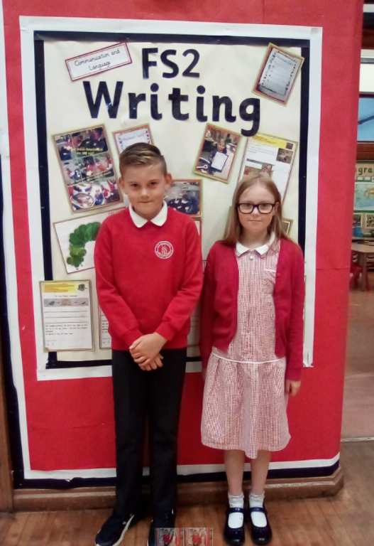
Uniform
All children need to wear black or grey trousers or skirts, a white polo shirt and a red school jumper with appropriate footwear.
For PE lessons, your child will need a white t shirt and black shorts. For outdoor PE they will need a warm tracksuit and trainers.
School uniform can be accessed from the school website in the parent’s section.
We are a cashless school, once you have started you will be set up with a school money account.

Slide 10
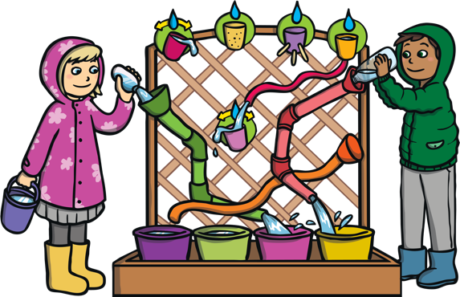
What does my child need at school?
Waterproof coat – this can be left at school
Wellies – please leave these in school
Book bag (school has provided this) – please bring everyday so letters, reading books etc. can be transported safely.
Water bottles – only water please.
Please label all items of clothing,
water bottles etc.

Slide 11
Home visits
On Tuesday 18th and Wednesday 19th June Miss Barton and Mrs Derrick will visit your house. This will just be a quick 5 –10 minute appointment, which allows us to meet your child in their own environment. Your appointment is in your welcome pack which you will receive at the end of this meeting.

Slide 12
Taster sessions
Your child is invited to a taster session on Tuesday 9th July 10.00am – 11.00am
Parents are welcome to attend this session.
Another taster session on Thursday 11th July 10.00am - 11:00am. Parents to leave their child.

Slide 13
What can I do to help my child?
Coats
Toilet
Count
Read lots of stories and poems
Learn together
Enjoy the summer holidays, have fun and enjoy this special time.

Slide 14
Finally
If you have any worries or concerns please contact us via the school office and we will do our best to help you.
Any questions – please email the admin office and we will get back to you.
admin@stnicholas.het.academy

